Slide 1


TRIBAL FOREST PROTECTION ACT OF 2004
ACQUISITIONS WEBINAR
NAVIGATING
CONTRACTS AND AGREEMENTS
BETWEEN TRIBES AND USFS
November 1, 2018
♦ 9:00 am-11:00 am Pacific Time
♦ 12:00 pm -2:00 pm (EDT)
♦ 10:00 am -12:00 pm (MDT)

Slide 2

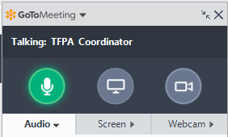
Webinar Instructions |
Control Panel
Your Mute/Unmute Status Button
Very important! Be sure to call in via telephone.
When prompted, enter into your phone:
The Access Code
AND Your Audio PIN Number

Slide 3

Webinar Instructions |
Control Panel
During Presentations, you are in LISTEN ONLY, please also MUTE your line
Please type a question / comment anytime during the Presentations
The Facilitator will keep a queue of comments/questions to start discussions.

Slide 4
Objectives
Discuss mechanisms for contracts and agreements on TFPA projects.
Share Pros, Cons, Success Stories and Lessons Learned on partnerships between Tribes and USFS.
Provide perspectives on obstacles and jointly develop solutions.

Slide 5
Agenda
Description | Presenter
Welcome, Introductions, and Webinar Objectives | Stephanie Lucero, TFPA Workshop Coordinator
Overview of TFPA in Terms of Acquisitions | Intertribal Timber Council
Contracts between Tribes and USFS | Gavin Smith, WO AQM Procurement Analyst
Partnering with Agreements and Grants | Allison Leiman, National G&A Policy Specialist
Facilitated discussion: | All Stephanie Lucero, TFPA Workshop Coordinator
Wrap up and Next Steps | Stephanie Lucero, TFPA Workshop Coordinator
Adjourn | All

Slide 6
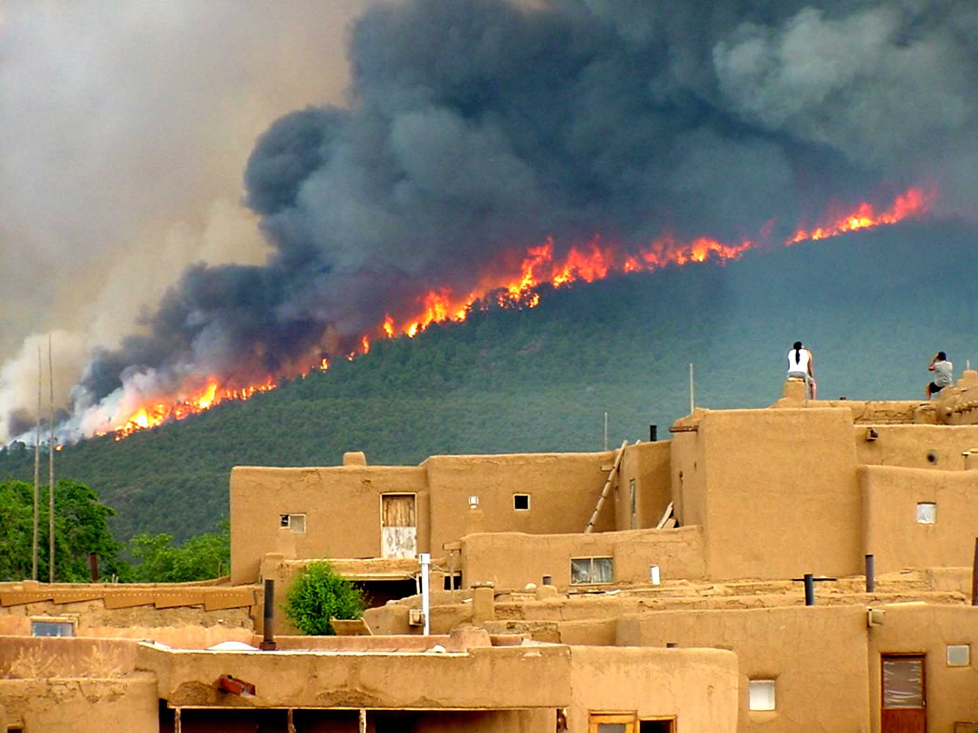
The History of TFPA: The West Was On Fire
Taos Photo 2003 by Ignacio Peralta, Photo courtesy of the Forest Service

Slide 7
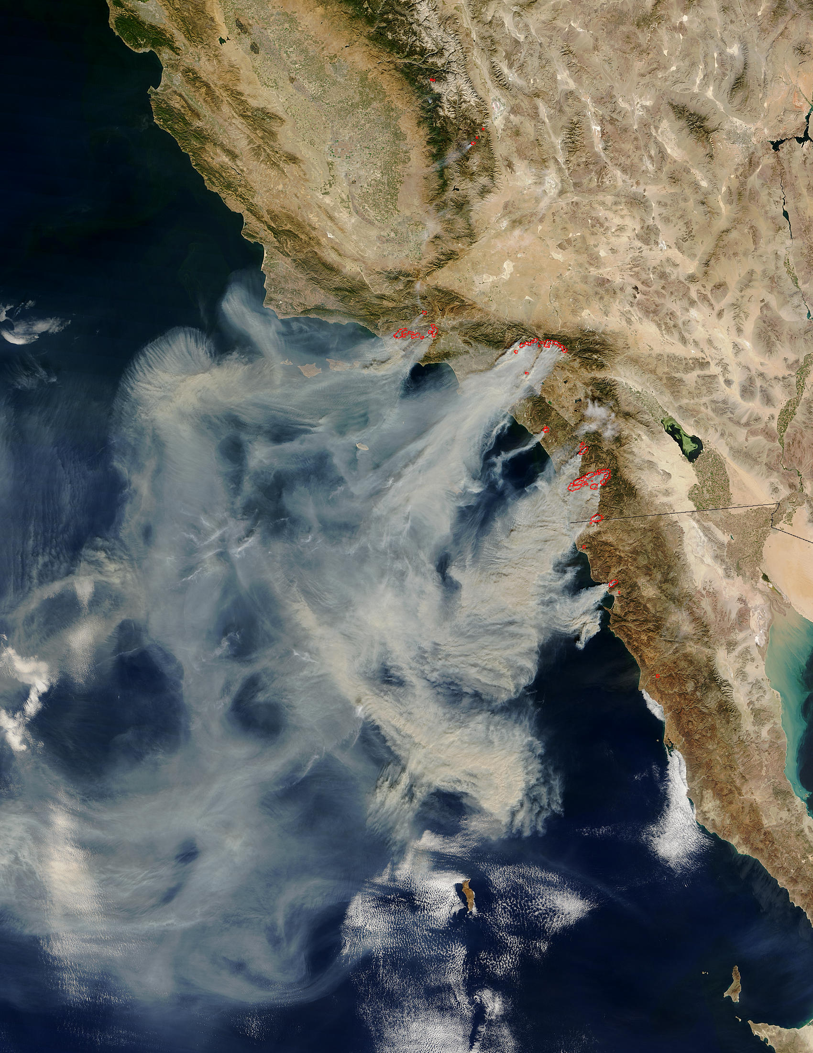
The Fire Siege of 2003
NASA/Goddard Space Flight Center Scientific Visualization Studio

Slide 8
TFPA History
Tribes went to Congress for legislation that would increase protection of tribal lands and resources throughout the United States.
The Tule River Tribal Council’s testimony for the TFPA stated:
“Every year we pray we are not the victims of catastrophic stand replacing fire, such as the devastation in Southern California.”
The Intertribal Timber Council’s testimony:
“applauds and strongly supports the Tribal Forest Protection Act.” It is “…a good opportunity to build partnerships that can produce results on the ground where they count.”
The TFPA passed in 2004 with bilateral support.

Slide 9
Key Terms
TFPA - Tribal Forest Protection Act of 2004
“Tribes”- refer to those tribal governments recognized by the federal government.
“Trust Responsibility”- the federal government has a legal responsibility to protect the interests and rights of Tribes and their members.
“Land in trust”- the US holds the legal title and the Tribe or individual Indian person holds the beneficial interest.
Notes:
.

Slide 10
TFPA Basics
The TFPA authorizes the Secretaries of Agriculture and Interior to give special consideration to tribally-proposed projects on USFS or Bureau of Land Management administered lands.
Emphasizes the government-to-government relationship between the federal government and Tribes.
Sets forth the goal for protection of trust lands.
Acknowledges Tribes’ historic and cultural interests.
Recognizes tribal relevant knowledge and skills.
See ITC TFPA handouts for specifics and details.

Slide 11
TFPA Basics
To qualify, the land (either tribal or allotted):
  Must be in trust or restricted status and
  Must be forested or have a grass, brush, or other similar vegetation, or
  Formerly had a forest cover or vegetative cover that is capable of restoration.

Slide 12
TFPA Basics
The Tribe must propose a specific project to take place on USFS (or BLM) administered land which:
  Borders or is adjacent to Indian trust land and
  Poses a fire, insect infestation, disease, and/or other threat to the Indian forest land or rangeland or a tribal community; or
  Is in need of land restoration.

Slide 13
TFPA Basics
The USFS administered area for the TFPA proposal:
  Should present or involve a risk to a feature or circumstance unique to the proposing Tribe (e.g., a risk to treaty rights; or biological, archaeological, historical, or cultural features), and
  Should not be subject to some other conflicting agreement or contract.

Slide 14
TFPA Basics
The USFS may respond to tribal proposals (approve or deny) within 120 days.
While TFPA provides a lot of discretion to the agency, Executive Orders, agency policy and many protocol agreements encourage timely responses.
TFPA authorizes USFS & BLM to enter into contracts and/or agreements directly with the Tribe or consider tribally-related factors when selecting the contractor and/or cooperator.
Collaboration prior to the submission of a formal proposal contributes to success.

Slide 15
TFPA Basics
The USFS can enter into an agreement or contract in response to the proposal with agency appropriated funds and/or other appropriate sources of funding.
Third parties may be involved in funding and doing the work on the ground.

Slide 16
TFPA Basics
For contracts, the FS can use “best value” and give special consideration to tribally-related factors such as, but not limited to:
The status of the Indian Tribe;
The trust status of the Tribe’s land;
The cultural, traditional, and historical affiliation of the Tribe with the land subject to the proposal.

Slide 17
Contracts and Agreements under
The Tribal Forest Protection Act of 2004
Why is this authorized?
U.S. Government responsibilities & interests
  Sovereign rights, Treaty & Trust responsibilities.
  USFS mission and values.
Tribal rights and interests
  Sovereign rights, Treaty rights & reserved rights.
  Cultural, Natural and Economic values & interests.

Slide 18
Contracts and Agreements under
The Tribal Forest Protection Act of 2004
There are a variety of tools to choose from:
  Stewardship Contracts
    IRTCs
    IRSCs
  Traditional Service Contracts
  Traditional Timber Contracts
  Partnership Agreements:
    Stewardship Agreements
    Participating Agreements
    Challenge Cost-Share Agreements

Slide 19
Contracts and Agreements under
The Tribal Forest Protection Act of 2004
Selecting an Instrument
Consider both parties’ needs and objectives:
  What are the treatment objectives?
  Are there requirements on how the work is executed?
  Timing restrictions or objectives?
  Economic needs to consider?
  Labor workforce needs to consider?

Slide 20
Contracts and Agreements under
The Tribal Forest Protection Act of 2004
Selecting an Instrument
Consider both parties’ resources:
  Where is the money coming from?
  Is there timber value?
  How much appropriated funding? Is it the right kind?
  Other sources of financial support? (Grants? Cooperators?)

Slide 21
TFPA PROJECTS CONTRACTING
Gavin Smith
WO Procurement Policy Branch

Slide 22
AFTER THE PROPOSAL IS APPROVED: CONTRACTS
The Basics of Contracting with the Government under TFPA
The contractor (e.g. Tribe, or tribal business) must be registered in the System for Award Management (S.A.M.)
All contracts will be with the affiliated Tribal Entity identified as the Prime Contractor
Existing contracts will not be canceled by the Government within the approved TFPA area.

Slide 23
What Contract Type to Use?
Contract Facts
  Under TFPA USFS have the authority to enter into Sole Source Contracts meaning no competition is required for Award.
  Traditional Service Contracts last for only 5 years.
  All covered activities are subject to the Service Contract Act which requires certain rates of pay and safety requirements as determined by the Department of Labor.
  Fair and Reasonable pricing is required for all acquisitions
Notes:
If Tribally affiliated business entity there may be other requirements.

Slide 24
What Contract Type to Use?
Small Business Set -Aside Contract Types (HUBzone, SDVOB, 8(a), WOSB):
Under the Federal Acquisition Regulations, if USFS awards under one of the set-aside contracting vehicles USFS have to use the following for performance:
  (1) Services (except construction), at least 50 percent of
  the cost of personnel for contract performance will be spent
  for employees of the concern or employees of other HUBZone
  small business concerns;
  (2) General construction. (i) At least 15 percent of the
  cost of contract performance to be incurred for personnel will
  be spent on the HUBZone prime contractor’s employees;

Slide 25
What Contract Type to Use?
Stewardship Contracting
  Use of this authority requires an approved Stewardship Proposal (generally the TFPA proposal restoration goals go hand in hand with stewardship)
  100% can be sub contracted
  Still requires the Tribal Entity to be identified as the Prime Contractor
  Trading of Forest Product value is allowed under the same contract
  New authority to contract for up to 20 years

Slide 26
What are Tribal Contractors Doing Now?
Notes:
THIS IS FROM DATASETS FROM 1982

Slide 27
What are Tribes Doing Now?
-ALL OTHER PROFESSIONAL, SCIENTIFIC, AND TECHNICAL SERVICES
-FINFISH FARMING AND FISH HATCHERIES
-OTHER SCIENTIFIC AND TECHNICAL CONSULTING SERVICES
-SUPPORT ACTIVITIES FOR FORESTRY
-LOGGING
-ADMINISTRATIVE MANAGEMENT AND GENERAL MANAGEMENT CONSULTING SERVICES
-RESEARCH AND DEVELOPMENT IN THE SOCIAL SCIENCES AND HUMANITIES

Slide 28
Conclusion: Contracts
Stewardship Contracting provides for the most flexible contracting methods for most TFPA type activities.
Other Contracting Tools are available and if you need assistance in setting your self up to contract with the government there are resources:
  Small Business Administration Offices
  Procurement Technical Assistance Centers (PTAC)
  Local Contracting Offices

Slide 29
TFPA PROJECTS GRANTS & AGREEMENTS
Allison Leiman
National G&A Policy Specialist

Slide 30
After the Proposal is Approved: Agreements
The Basics of Agreements with the Government under TFPA
All cooperators working with the USFS must be registered in the System for Award Management (S.A.M.)
Projects can be stand-alone in nature or part of a broader master agreement with the agency.
Projects must be within the scope of a partnership or assistance authority and meet all of the associated requirements (ex. meet mutual interest and benefit parameters).

Slide 31
Agreement Considerations:
  Under TFPA, USFS can partner using any of available authorities where a tribal government is an allowable cooperator.
  Most agreements last for 5 years with some authorities allowing for extended periods of performance.
  There must be funding available for the anticipated project and the cooperator must meet cost-sharing requirements as specified in the authorizing statute and/or agency policy.
  Costs associated with carrying out the project must be reasonable, allowable and allocable.

Slide 32
Agreement Considerations, contd.:
Avoid conflict of interest or the appearance of conflict.
Product or company endorsement is not authorized.
If the USFS does not have the statutory authority to perform work, it can’t be done through another party.
Does the project meet the USFS area’s mission along with the cooperator’s mission?
Does the cooperator have the capacity needed to perform their portion of the agreement, including any cost sharing if required?
Can the project be accomplished in a timely manner?

Slide 33
What Agreement Type to Use?
Federal Financial Assistance: Used to transfer money, property, services or anything of value to a recipient in order to accomplish a public purpose of support or stimulation which is authorized by Federal statute.
Partnership Agreements: Used to document a cooperative exchange of resources and funding with a non-federal party to accomplish projects that are of mutual interest and benefit.
Specialized Agreements: Used to document cooperation and funding between the USFS and other specific parties for: Cooperative Law Enforcement, Cooperative Road, and Cooperative Fire Agreements.

Slide 34
What Agreement Type to Use, contd.?
Collection Agreements: Used for the acceptance of money by the USFS from a non-Federal party to carry out a purpose authorized by law.
Interagency Agreements: Used when one Federal agency is in a position to provide materials, supplies, equipment, work, or services of any kind that another agency needs to accomplish its mission.
Memoranda of Understanding: Used to document a framework for cooperation between the USFS and other parties for carrying out their separate activities in a coordinated and mutually beneficial manner where nothing of value transfers between parties.

Slide 35
Stewardship Agreements and TFPA
The Stewardship End Results Contracting authority allows the USFS to enter into agreements with non-federal parties to meet restoration objectives that are of mutual interest and mutual benefit to both parties.
The USFS may apply the value of timber or other forest products as an offset against cost of services performed.
Projects primarily focus on meeting restoration objectives on National Forest System (NFS) land, but in some cases, work can take place off NFS where specific requirements are met.
Notes:
Tribes are considered non-federal parties as compared to other federal agencies (Interagency agency)

Slide 36
Conclusion: Agreements
Tribes and Tribal organizations are key cooperators across the USFS.
The use of agreements can greatly enhance shared mission objectives and cost sharing of resources to achieve critical results.
Most any activity that is approved via TFPA proposal can be carried out using an agreement tool.

Slide 37
Questions or comments?
Notes:
Work with local tribal liaisons and District Rangers, grants managers and contracting lead within the Forest or region. Tribal liaison or District rangers are best options to identify right people to ask specific questions.

Slide 39
Contracts and Agreements under
The Tribal Forest Protection Act of 2004
Selecting an Instrument
Consider both parties’ resources:
  Where is the labor and equipment coming from?
  Does the Tribe have manpower, organization & equipment to succeed? Part of it? All of it?
  What does the local contractor pool look like?
  Do other cooperators have manpower, equipment and organization to execute part or all of it?
  If there is product removal, where is the material going to?

Slide 40
Contracts and Agreements under
The Tribal Forest Protection Act of 2004
Consider the nature of the instruments:
Contracts – binding in nature, but Contractor may benefit greater financially.
Agreements – not binding; easy to change or terminate; may require match.
A comprehensive approach may also include a combination of tools.

Slide 41
Contracts and Agreements under
The Tribal Forest Protection Act of 2004
Contracts and Agreements under
The Tribal Forest Protection Act of 2004
AGREEMENTS
  Stewardship Agreements
  Traditional Agreements
    Participating (20% match; specific work types; allows advance payments)
    Challenge Cost-Share (20% match)
    Collection
    Other
Notes:
Participating Agreements: under two different aspects of the authority: Forestry Protection: This is the section where we focus on hazardous fuel reduction work, or other forestry related work. Job training/manpower development: we have a number of these agreements with tribes to host their training programs, particularly when it comes to fire crews or other natural resource work. OTHER Agreements may include agreements like Cooperative Fire Agreements.

Slide 42
Contracts and Agreements under
The Tribal Forest Protection Act of 2004
Contracts and Agreements under
The Tribal Forest Protection Act of 2004
AGREEMENT CONSIDERATIONS:
  What does TFPA do for Agreements?
    Agency / Cooperator relationship.
    Agreements are non-binding legal instruments.
    Other requirements or restrictions (i.e. matching requirements, or specific activities or locations)
    Tribe: Tribal Authority
    Federal Government: Line Officers

Slide 43
Contracts and Agreements under
The Tribal Forest Protection Act of 2004
Contracts and Agreements under
The Tribal Forest Protection Act of 2004
CONTRACTS
  Traditional contracts
    Procurement Contracts (purchase services)
    Timber Contracts (sell goods)
  Stewardship Contracts (trade goods for services)
    Integrated Resource Timber Contracts (IRTCs)
    Integrated Resource Service Contracts (IRSCs)
    Service Stewardship Contracts
Notes:
Stewardship contracts – trade goods for services.

Slide 44
Contracts and Agreements under
The Tribal Forest Protection Act of 2004
Contracts and Agreements under
The Tribal Forest Protection Act of 2004
CONTRACTS
  Timber Contracts (income)
    Timber Contracts (income to US Treasury)
    Integrated Resource Timber Contracts (IRTCs)
  Procurement Contracts (expenditure)
    Traditional Service Contracts
    Integrated Resource Service Contracts (IRSCs)
    Service Stewardship Contracts
Notes:
Timber contract: money to Treasury; IRTC: retained receipts.
Service Stewardship contracts: FS can utilize retained receipts

Slide 45
Contracts and Agreements under
The Tribal Forest Protection Act of 2004
Contracts and Agreements under
The Tribal Forest Protection Act of 2004
CONTRACTING CONSIDERATIONS:
  Contracting Agency / Contractor relationship.
  Contracts are binding legal instruments.
  Sovereign Immunity & the business transaction.
  Tribe: Tribal Authority
  Federal Government
    Procurement Contracting Officer (IRSCs & Service)
    Timber Contracting Officer (IRTCs & Timber Sales)

Slide 46
Contracts and Agreements under
The Tribal Forest Protection Act of 2004
Contracts and Agreements under
The Tribal Forest Protection Act of 2004
CONTRACTING:
How does TFPA fit in the framework of other federal contracting regulations?
  Non-competitive: TFPA authorizes the Agency to contract directly with a tribe if the conditions stated in the Act are met.
  Competitive. TFPA authorizes the use of tribally-related evaluation factors.

Slide 47
Contracts and Agreements under
The Tribal Forest Protection Act of 2004
Contracts and Agreements under
The Tribal Forest Protection Act of 2004
CONTRACTING:
How does TFPA fit in the framework of other federal contracting regulations?
  Non-competitive:
    Federal Acquisition Regulations (FAR): FAR 6.302-5: Authorized or Required by Statute.

Slide 48
Contracts and Agreements under
The Tribal Forest Protection Act of 2004
Contracts and Agreements under
The Tribal Forest Protection Act of 2004
Non-Competitive Process (Procurement):
    Project approved.
    “Pre-solicitation” meetings with Tribe.
    Evaluation Criteria selected, if relevant.
    Draft solicitation.
    Issue solicitation to selected Tribe.
    Pre-proposal conference.
    Receive and evaluate proposal.
    Award Contract.
    Pre-work Meeting / Start Work.

Slide 49
Contracts and Agreements under
The Tribal Forest Protection Act of 2004
Contracts and Agreements under
The Tribal Forest Protection Act of 2004
CONTRACTING:
How does TFPA fit in the framework of other federal contracting regulations?
  Competitive: TFPA authorizes the Government to use “Best Value” contracting to make the award decision.

Slide 50
Contracts and Agreements under
The Tribal Forest Protection Act of 2004
Contracts and Agreements under
The Tribal Forest Protection Act of 2004
CONTRACTING ISSUES:
How does TFPA fit in the framework of other federal contracting regulations?
  Competitive: The normal use of evaluation criteria in our competitive solicitations frequently includes the following evaluation factors:
    Technical Approach
    Past Performance (required by FAR)
    Benefits to Local Community (specific authorities for stewardship and hazardous fuels reduction)

Slide 51
Contracts and Agreements under
The Tribal Forest Protection Act of 2004
Contracts and Agreements under
The Tribal Forest Protection Act of 2004
CONTRACTING ISSUES:
How does TFPA fit in the framework of other federal contracting regulations?
  Competitive: TFPA authorizes the use of additional “Proposal Evaluation & Determination Factors”
    Status of Indian tribe as an Indian tribe
    Trust status of the Indian forest land or rangeland of the tribe
    Cultural, Traditional, historical affiliation with the land
    Treaty rights or reserved rights associated with the land
    Indigenous knowledge and skills of tribe
    Features of the landscape of the land, incl. watersheds & veg.
    Working relationship between tribe and Agencies in coord. activities.
    The access by members of the tribe to the land.

Slide 52
Contracts and Agreements under
The Tribal Forest Protection Act of 2004
Contracts and Agreements under
The Tribal Forest Protection Act of 2004
Competitive Process (Procurement):
    Project approved.
    Evaluation Criteria selected.
    Draft solicitation.
    Issue (advertise) solicitation.
    Pre-proposal conference.
    Receive and evaluate proposals.
    Award Contract.
    Pre-work Meeting / Start Work.

Slide 53
Contracts and Agreements under
The Tribal Forest Protection Act of 2004
TAKE HOME MESSAGES
The USFS can enter into contracts or agreements directly with the Tribe when certain criteria are met.
Stewardship contracts/agreements are not mandatory for TFPA projects, but may have advantages that make them useful vehicles for carrying out TFPA projects.
The agency has discretion in awarding contracts and may use a variety of competitive or non-competitive processes.
The Agency may use a “Best Value” evaluation process for contract award, and must use that process for stewardship contracting.

Slide 54


To Receive Continuous Learning Points
Please Ensure your Name and Email are Accurate
Email lucero.stephanie@gmail.com
by November 23, 2018, with the following information:
  First and Last Name
  Confirmation Code
    X18DDMHUR
  Email to send certificate.
Lucero.stephanie@gmail.com

